Slide 1

Special Education Advisory Council
(SEAC)
2022-2023
Notes:
NOTE:
To change the image on this slide, select the picture and delete it. Then click the Pictures icon in the placeholder to insert your own image.

Slide 2
Welcome
Special Education Advisory Council Members (SEAC)
Meta Johnson, Pupil Services Coordinator
Candance Lucas, Policy & Procedures Coordinator/Community Liaison
Marquita Horton, Rachel Wright, Quinesha Gordon, Jessica Turner
Parents of Dalton/Lanier Elementary/Glen Oaks Middle students
Earnestine Banks, Educational Diagnostician
Twila Perniciaro/Terri Johnson, Speech Therapists
Leslie Malveaux/Tshanda Vaughns-Secretary/Erica McClain, ESS Teachers

Slide 3
SEAC
The Special Education Advisory Committee (SEAC) (pronounced “seek”) is a State-mandated, district-level committee charged with providing input to the school district regarding special education and related services under the Individuals with Disabilities Education Act (IDEA) and Louisiana Department of Education (LDE) Bulletin 1706.

Slide 4
Meeting Agenda
Who and Why
RSL Special Education Advisory Council (SEAC) is an opportunity for parents, district staff, and community stakeholders to engage in discussion and promote positive communication and feedback regarding special education policies, procedures, and resources.
The SEAC provides advise on the development of programs to meet the special educational needs of children and families. By sharing these programs for students, parents can become active partners in their child’s education and as a result, outcomes for children with disabilities should improve.

Slide 5
The Redesign Schools Louisiana SEAC:
Advise-Advises on current issues, program development, parental concerns and involvement
Advocate-Serves as an advocate for high-quality special education programs
Promote-Promotes communication between family, school, and community

Slide 6
What’s New?
Programs and Services
Multi Tiered Support System (MTSS) FASTalk
Dynamic Indicators of Basic Early Literacy Skills (DIBELS) screenings and assessments
Acceleration Dyslexia Screenings
Universal Design of Learning (UDL) Social-Emotional Learning (SEL)
ST Math Weekly Newsletter
Study Island Paromana Education
Blue Engine Special Education Leader Fellowship (SELF)
ACT 456

Slide 7
Community Involvement
Tutoring
Parent Square
Families Helping Families
Resources for Parents of Students with Disabilities
The Source

Slide 8
A Look at Our ESS Staff and Population
Schools
Dalton Elementary
Lanier Elementary
Glen Oaks Middle
Additional Support Staff
Speech Therapists (2)
Adapted Physical Education Teacher (1)
Occupational Therapist (1)
School Counselor (3)
Educational Diagnostician (1)
Teachers | Students | Support Staff
2 | 29 | 3
2 | 20 | 2
1 | 16 | 1
Total Students | 65

Slide 9
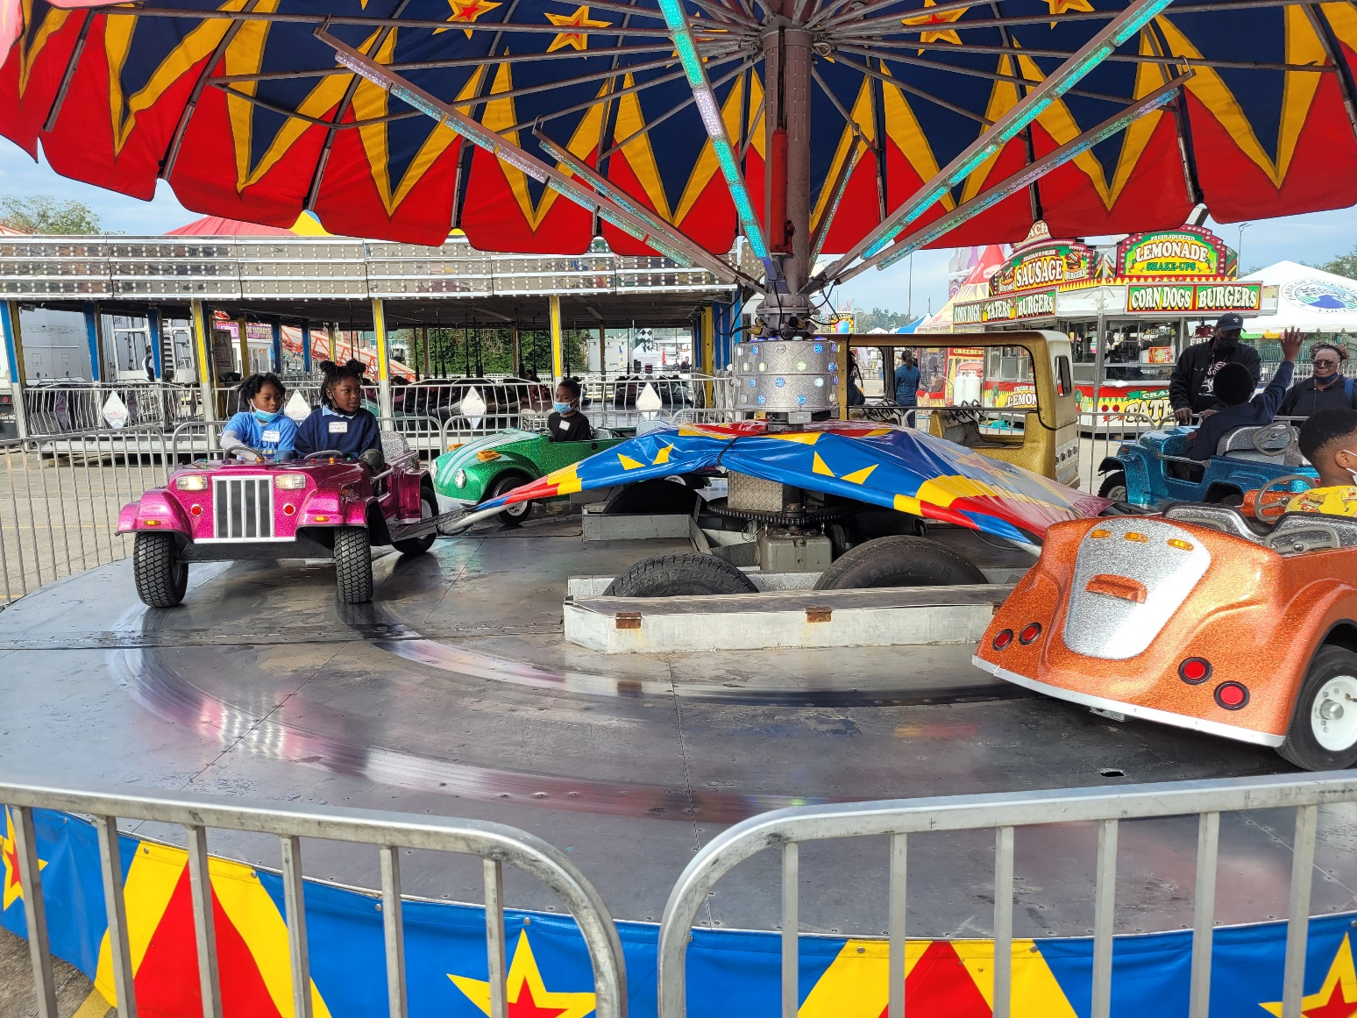
Focus, Issues & Concerns
ESS is starting the year out with fun and excitement that promotes continued learning and engagement.
All students are engaged in a rigorous curriculum to maximize student learning.

Slide 10
Q & A
Next Meetings Dates
See you next time! Thank you for your participation!
Happy Holidays!

